Slide 1

Cloud Computing
DAFT OCT 2021 - Filipe Gardete

Slide 2
Cloud Computing
What is Cloud Computing?
As a curiosity the term “Cloud” started to be in the 90’s as a metaphor for the internet.
Cloud computing is the delivery of computing services, including servers, storage, databases, networking, software, (data) analytics and intelligence, over the Internet (“cloud").
The first cloud computing services are no more than a decade old. Before their appearance, we used to buy the IT resources, but now Instead of buying, owning, and maintaining them we can access technology services, on an as-needed basis from what is called a cloud provider.
Cloud providers often have services distributed over multiple locations, each location being a (big) data center.
The goal of applying Cloud Computing is to more quickly deliver innovation, flexibilize resources and generate savings.
Cloud computing is a stated fact in our days!

Slide 3
Cloud Computing
Types of cloud computing
There are three principal types of cloud computing:
1. Infrastructure as a Service (IaaS).
2. Software as a Service (SaaS).
3. Platform as a Service (PaaS).

Slide 4
1. Infrastructure as a Service (IaaS):
This is the most basic category of cloud computing services. With IaaS, IT infrastructure is leased — servers and virtual machines (VMs), storage, networks, operating systems — from a cloud provider on a pay as you go model.
Note:
1) A virtual machine (VM) is a software that runs programs or applications without being tied to a physical machine.
2) A server is a piece of computer hardware or software (computer program) that provides functionality for other programs or devices, called “clients”.

Slide 5
2. Software as a Service (SaaS):
SaaS is nothing more than software distribution in which a software is hosted by the providers and made available for the customers over the internet. With SaaS, cloud providers host and manage the software and underlying infrastructure and take care of all maintenance such as software updates and security patching. Users connect to the application via the Internet, usually with a browser (and eventually with an API) on their mobile phone, tablet or computer.

Slide 6
3. Platform as a Service (PaaS):
This category refers to provided services that create an environment for developing, testing, delivering and managing applications over the internet. This service category is designed to allow developers to quickly create web or mobile applications without having to worry about configuring or managing the underlying infrastructure of servers, storage, network and databases needed for development.

Slide 7
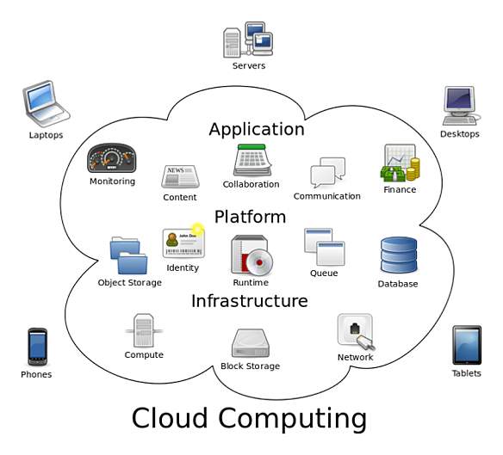
Types of cloud computing
Each type of cloud computing provides different levels of flexibility, control, and management so that you can select the right set of services for your needs. This is what is called cloud computing stack.
Another important thing is that you only pay for the cloud services you use, which helps you (i) reduce running costs, (ii) run infrastructure more efficiently, and (iii) scale the business, when needed .

Slide 8
Cloud Computing
Who are the main global providers of (public) Cloud Computing Services?
Microsoft Azure
Google Cloud Plataform
Amazon Web Services (AWS)

Slide 9
Cloud Computing
Benefits of cloud computing?
Efficiency/cost reduction
Scalability
Data Security
Deploy globally very fast

Slide 10
Cloud Computing
In Conclusion:
Who is using cloud computing?
Nowadays, almost all companies of every size, type, and industry are using cloud computing. They use cloud computing for: (i) data backup, (ii) virtual desktops, (iii) email, (iv) software development and testing, (v) big data analytics, (vi) delivering of games, (vii) streaming of music, movies and series and also to save money, get a better vision of innovation and customer requirements.
Even governments are shifting to cloud computing.
It's likely that you're using cloud computing right now, even if you don't realize it. If you use an online service to send e-mails, edit documents, watch movies or television, listen to music, play games or store images and other files, chances are you can only do so because cloud computing is working in second plan.

Slide 11
THANKS!

